Slide 1
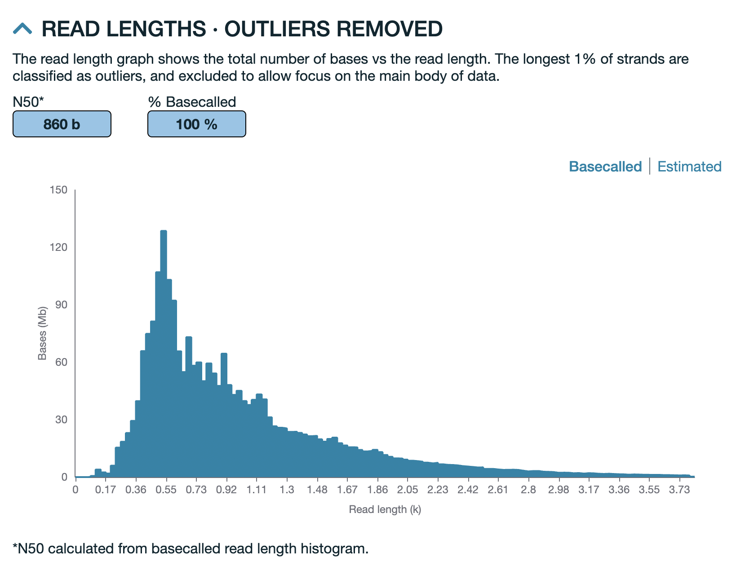
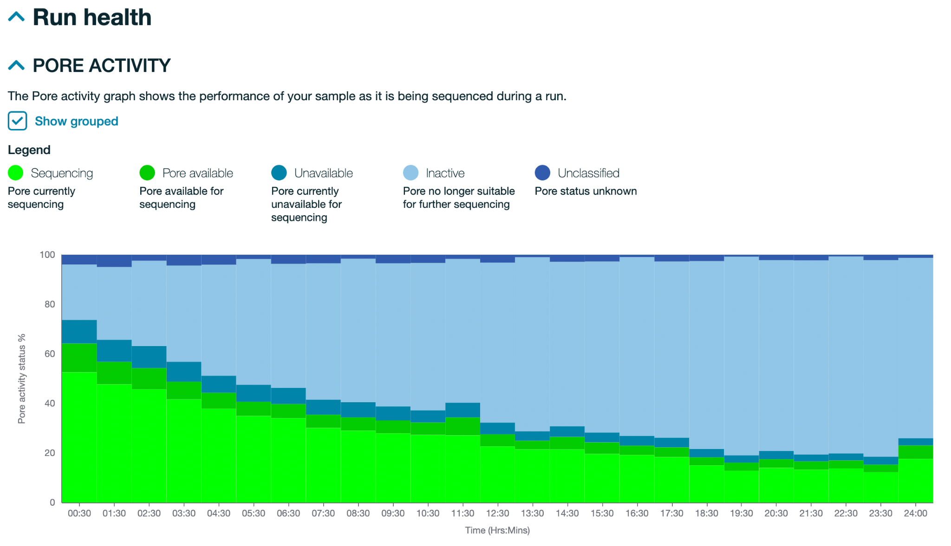
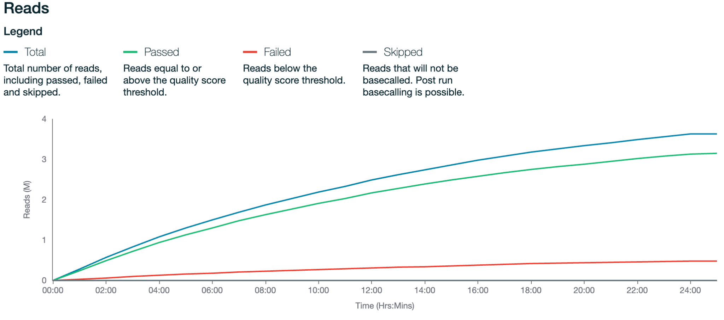
Sequencing run QC
for ONT
Rapid Response – Revised Sept 2026

Slide 2
What is covered in this section?
Run output files
Sequencing run report
Next steps

Slide 3
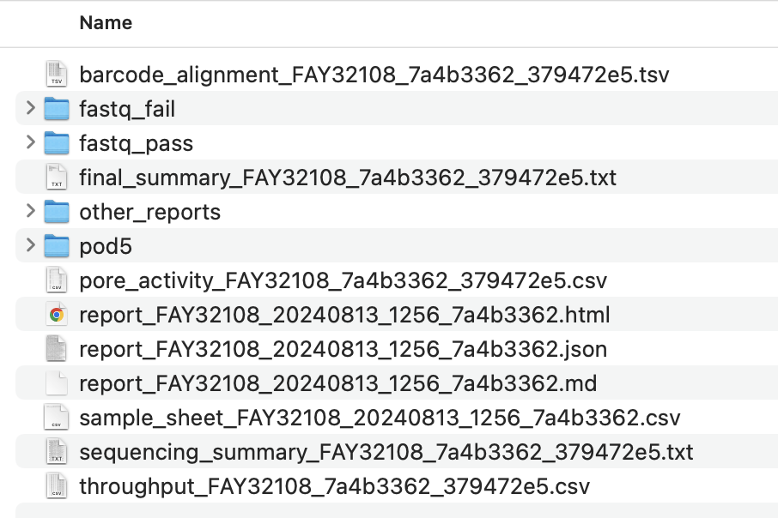
Output files generated from ONT run
Run Folder:
Basecalled fastq files
(fail = Q-score is below threshold set during sequencing run (9 by default))
Raw sequencing files
Summary report for doing QC

Slide 4
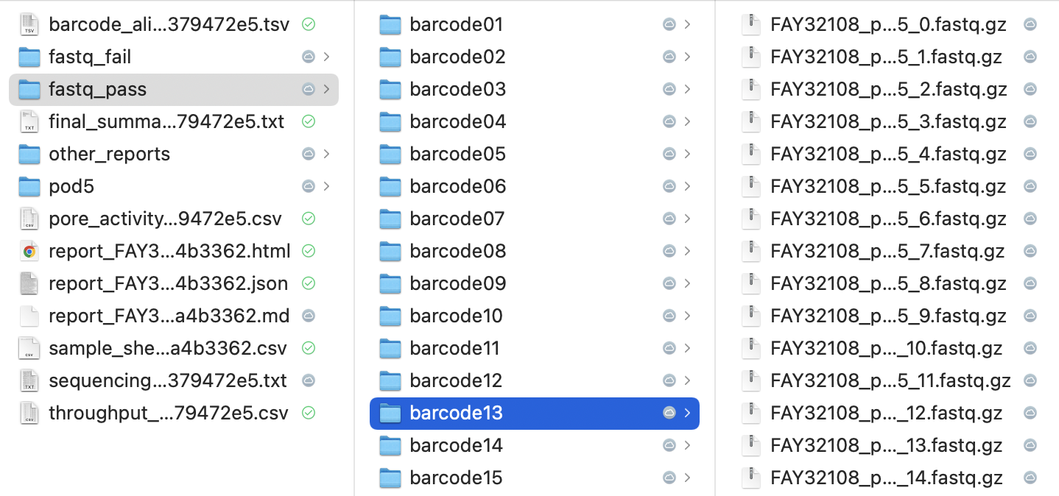
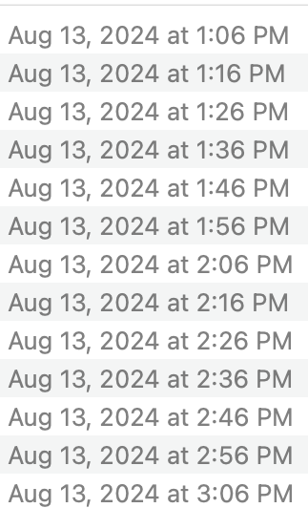
Output fastq file organization
Reads are automatically demultiplexed during basecalling
Fastq files are generated in real-time (every 10 minutes in this example), so many fastq files are generated for each barcode (sample)

Slide 5
Sequencing run QC using the “report_***.html” file
Run Folder:
Summary report for doing QC

Slide 6
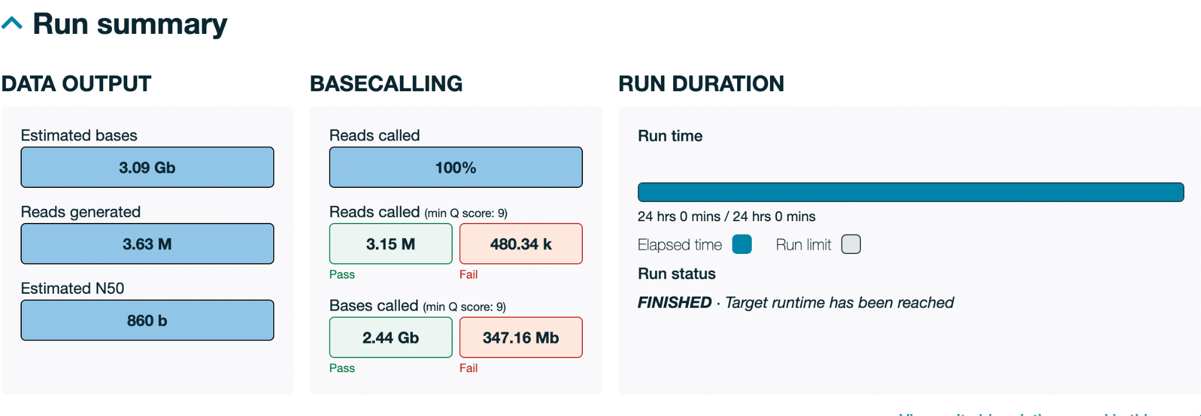
Amount of Data Generated
Check that the amount of data generated matches your expectation (this is a function of library loading concentration, run time, number of pores available for sequencing)
For a fresh flow cell with a run that’s 48+ hours, ONT claims ~20 Gbases of data will be generated, but in practice, this number is ~1-6 Gbases
If the flow-cell is being re-used and has <800 pores left (like example below), data generated will be lower

Slide 7
Read length distribution
Check that the distribution of read lengths matches expectation (depends on quality of sample going in, whether fragmentation was performed, etc.)
Distribution should roughly match the library size seen in QSep/Tapestation/diagnostic PCR, although it’s common for read lengths to skew shorter

Slide 8
Cumulative output as a function of time
Cumulative output should start out linear and then plateau off as pores get exhausted
>80% of bases should pass the Q-score threshold (usually set to 9)
✓

Slide 9
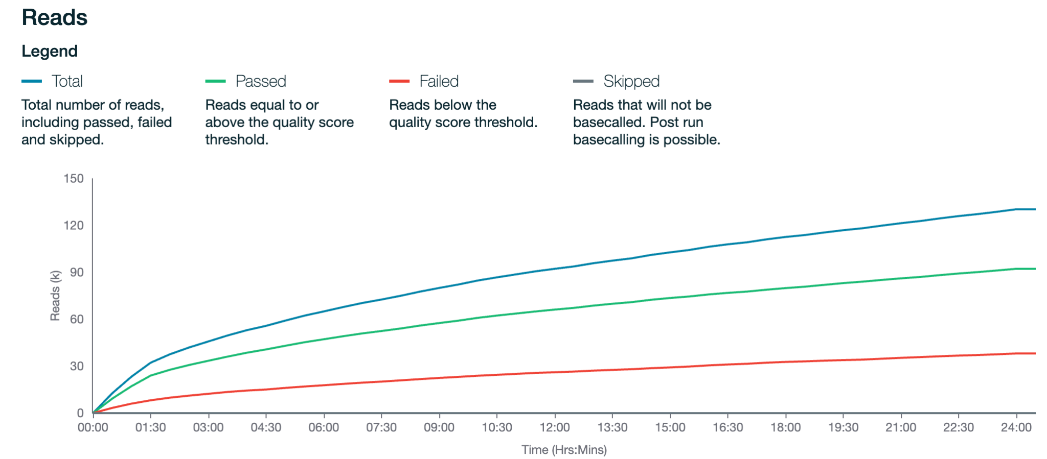
Cumulative output as a function of time
Cumulative output should start out linear and then plateau off as pores get exhausted
>80% of bases should pass the Q-score threshold (usually set to 9)

Slide 10
Cumulative output as a function of time
Cumulative output should start out linear and then plateau off as pores get exhausted
>80% of bases should pass the Q-score threshold (usually set to 9)
✘
Sharp change suggests abrupt reduction in output

Slide 11
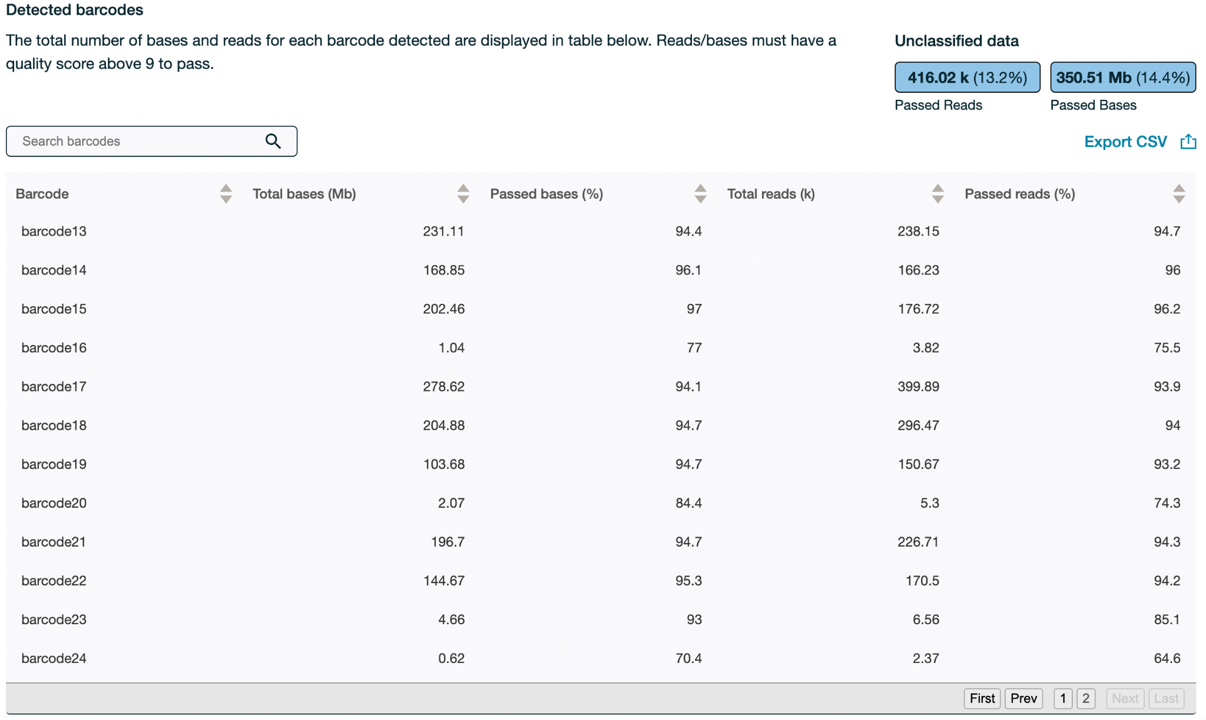
Distribution of reads/bases across barcodes
Check that this matches expectation - we generally aim for even distribution across barcodes*
*When setting up a run, there is the option (beta) to do barcode balancing by not sequencing overrepresented barcodes, but this hasn’t been tested by RR team

Slide 12
Distribution of reads/bases across barcodes
Check that this matches expectation - we generally aim for even distribution across barcodes*
Use this to evaluate your sample normalization / pooling
*When setting up a run, there is the option (beta) to do barcode balancing by not sequencing overrepresented barcodes, but this hasn’t been tested by RR team

Slide 13
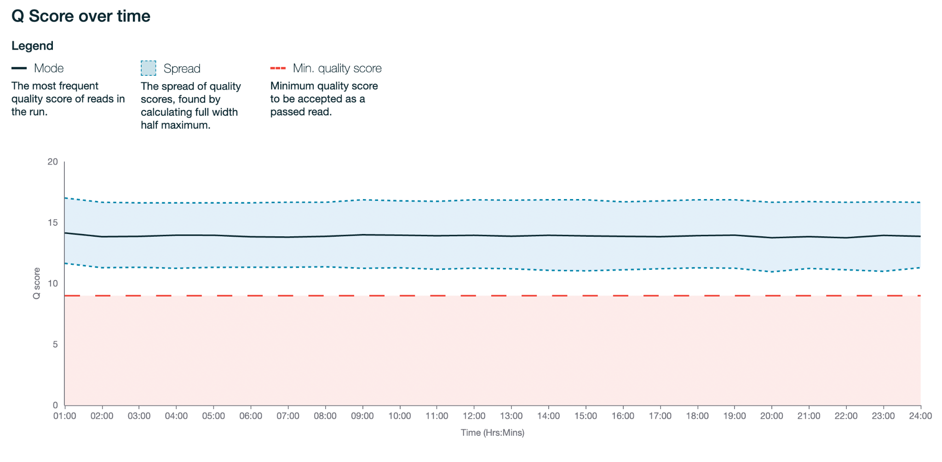
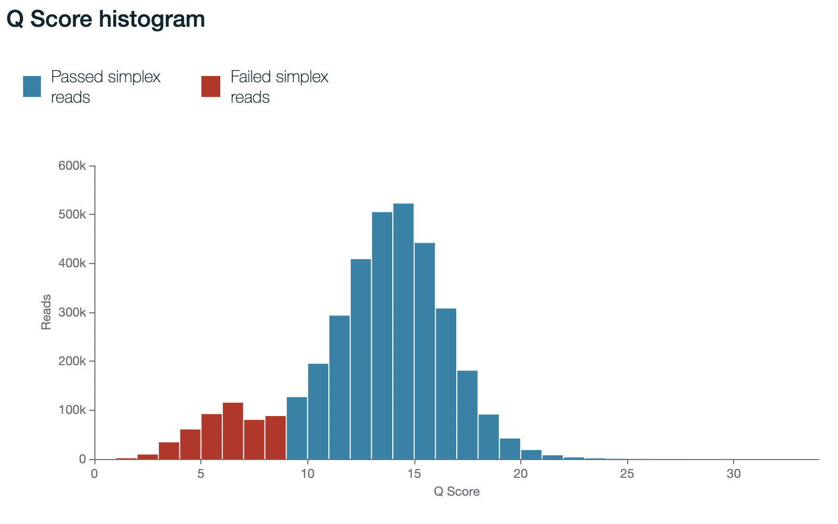
Q-score
A mean score of 15 is typical for HAC basecalled runs
  Q-score depends on the basecaller used
Ideally, Q-scores will remain steady over time
✓
Notes:
Add definition

Slide 14
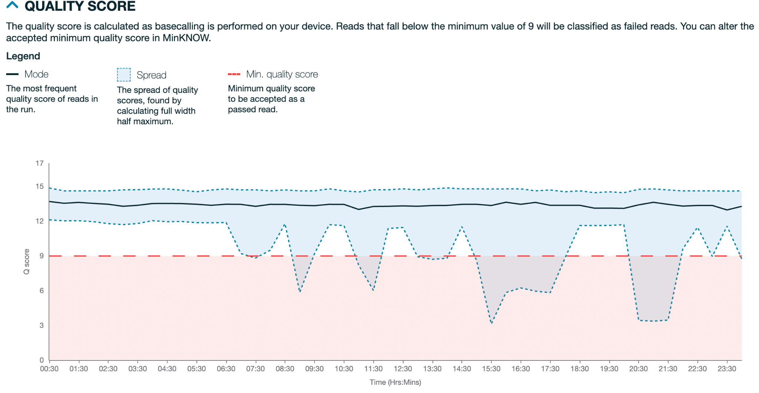
Q-score
A mean score of 15 is typical for HAC basecalled runs
  Q-score depends on the basecaller used
Ideally, Q-scores will remain steady over time
✘
Greater variation (reduction) in Q-score at later times

Slide 15
Pore activity over time
Sequencing/available pores gradually decrease over time, with slight increases when pore scans are performed
✓

Slide 16
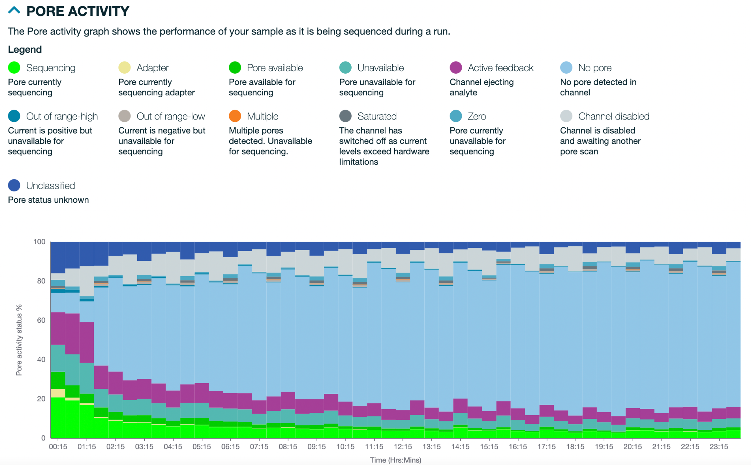
Pore activity over time
See here for how to diagnose issues based on pore activity plots
Lots of unusual pore statuses
Low starting % of active pores
✘

Slide 17
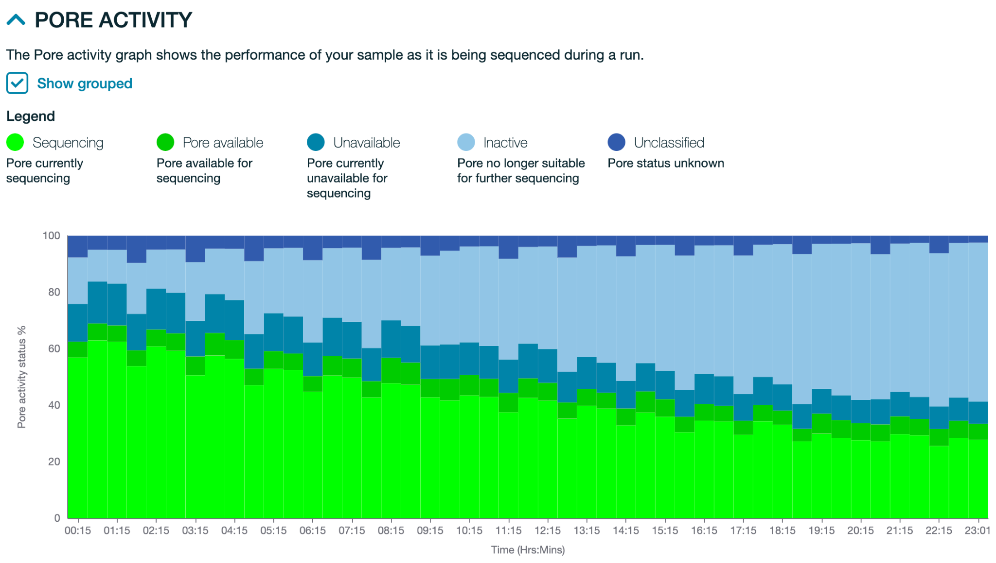
Pore activity over time can also help indicate if the right amount of library was loaded
Was the right amount of library loaded?
We aim for a high % of pores sequencing (light green)
We want to reduce the % of available pores that are not sequencing (dark green). These pores are likely to become unavailable over time.
Almost all available pores are sequencing (light green) - this is great!

Slide 18
Pore activity over time can also help indicate if the right amount of library was loaded
Pore activity can provide information on how optimally the flow cell was loaded - was the right amount of library loaded?
✓
Great loading!
Almost all available pores are sequencing

Slide 19
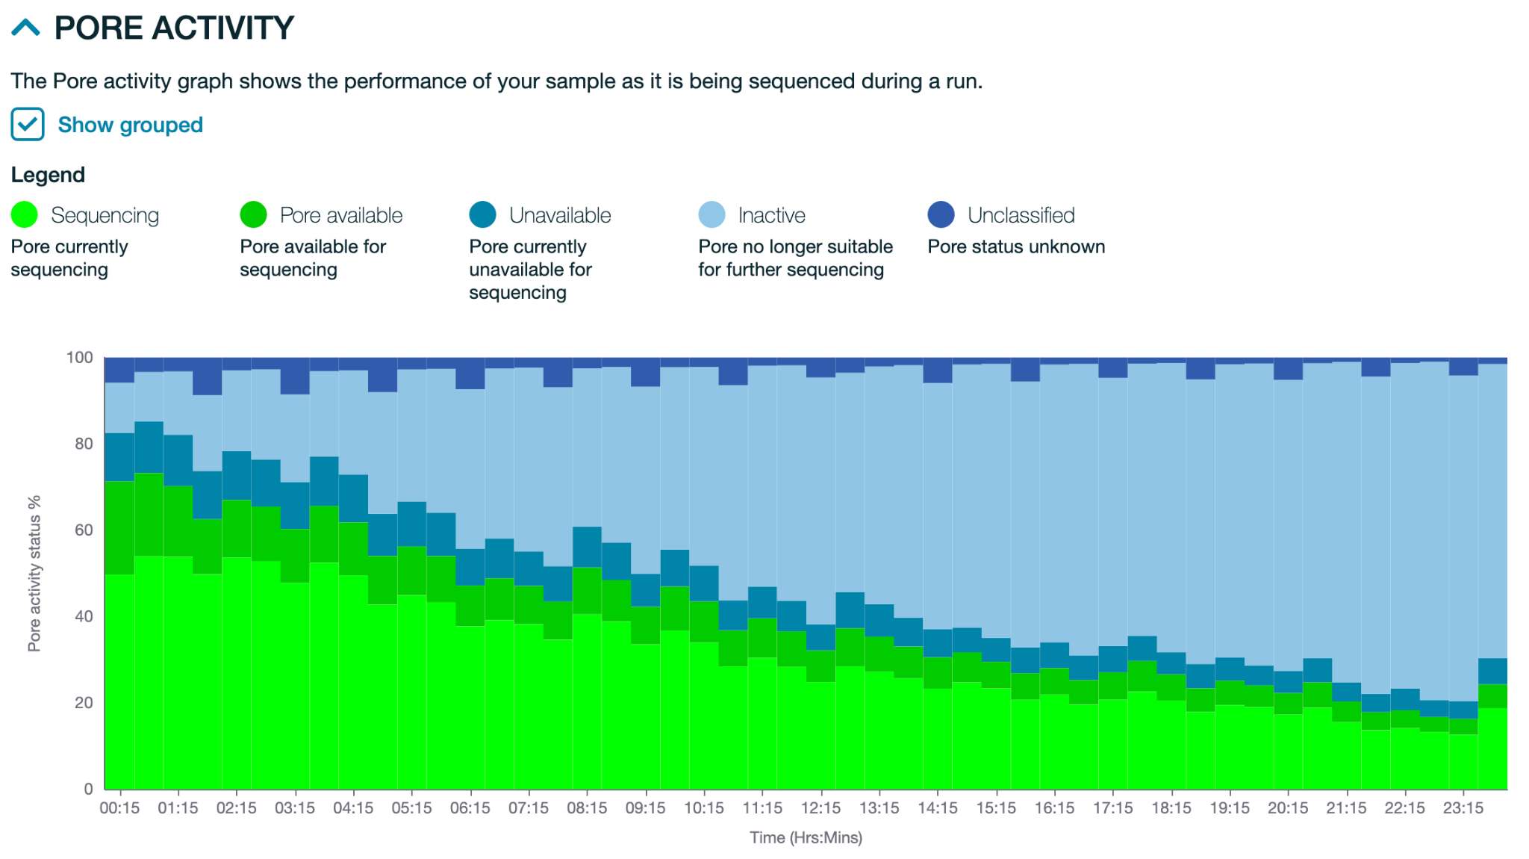
Pore activity over time can also help indicate if the right amount of library was loaded
Pore activity can provide information on how optimally the flow cell was loaded - was the right amount of library loaded?
✓
Okay loading, but next time could load more fmol
There are still available pores (dark green)

Slide 20
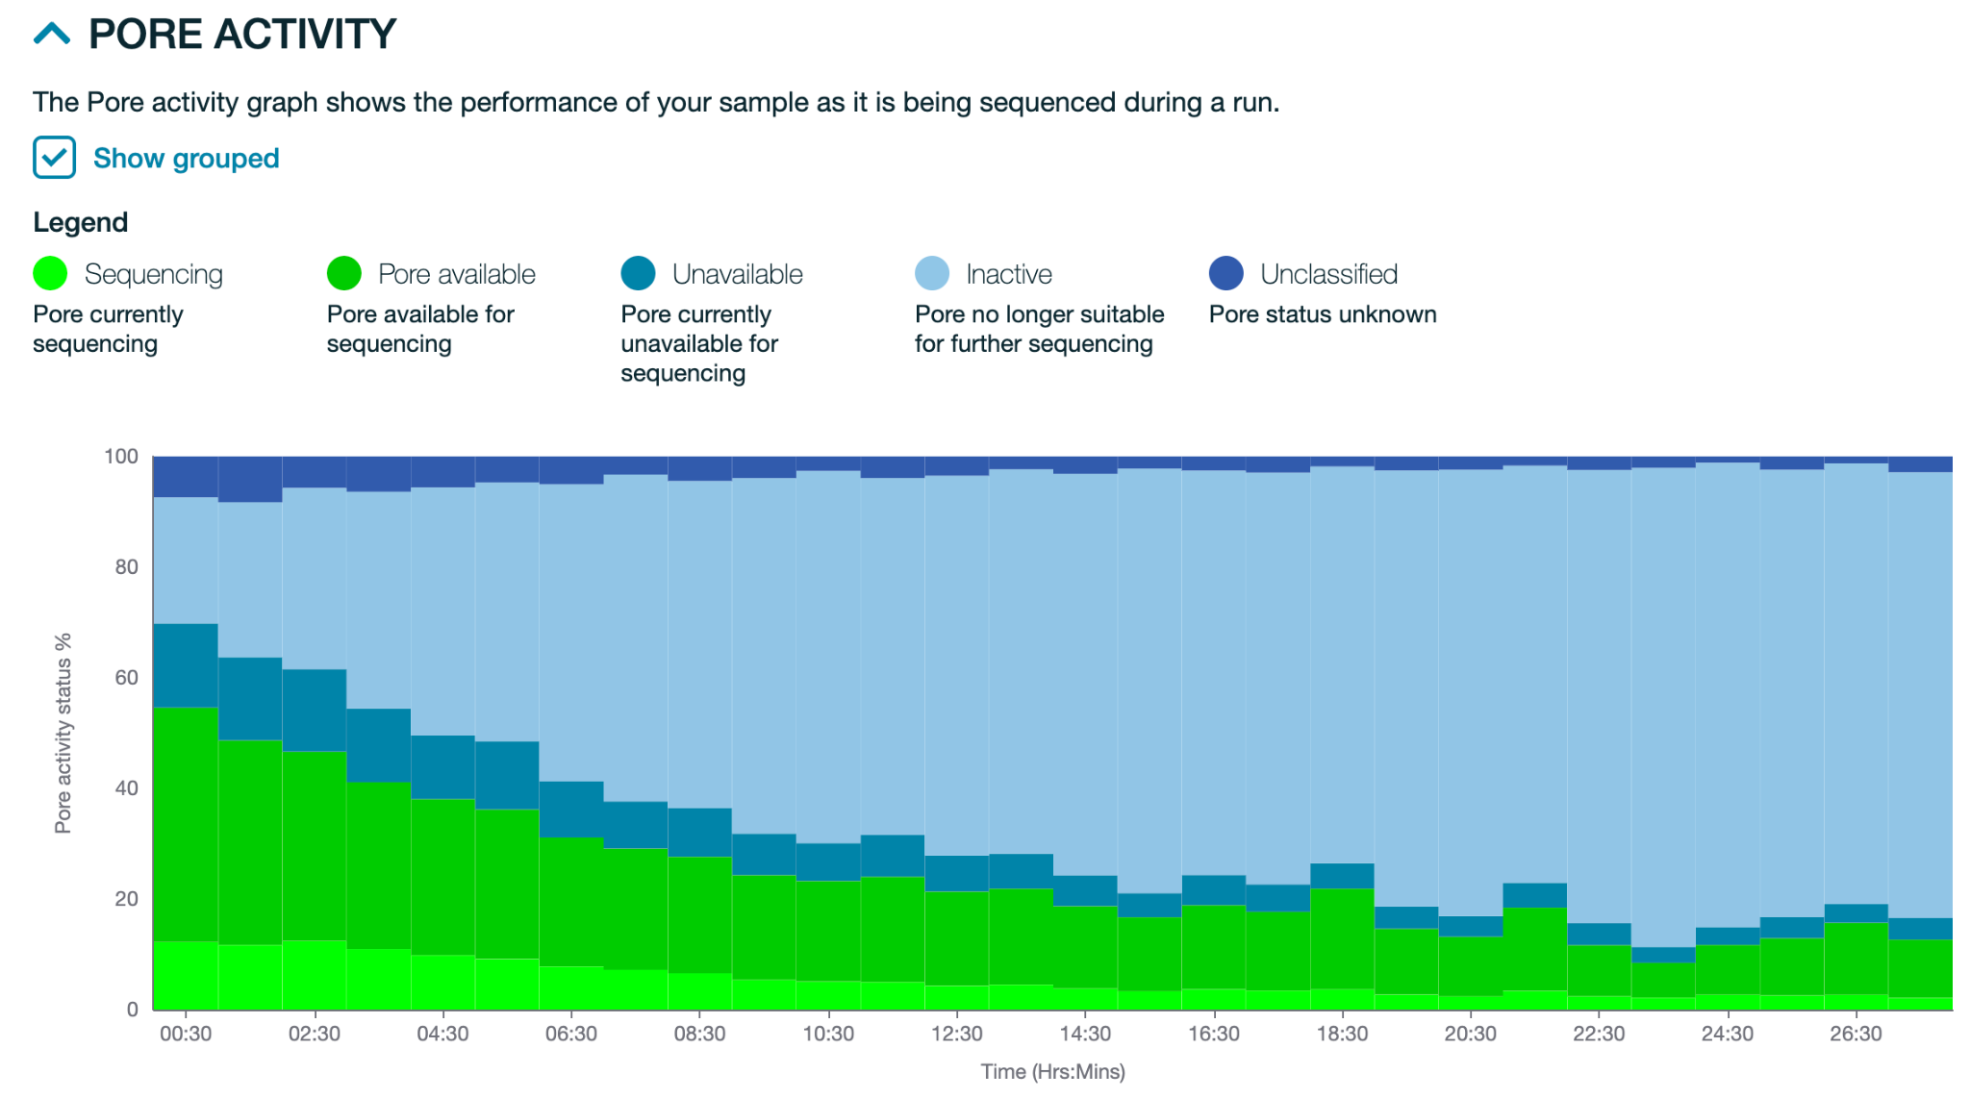
Pore activity over time
Pore activity can provide information on how optimally the flow cell was loaded - was the right amount of library loaded?
✘
Under loaded - there are too many pores available.
Next time load more fmol of library

Slide 21
Run review exercise
Worksheet: Sequencing Run QC for ONT - Activity
How much output (reads, bases) was generated?
  Hint: consider how many pores were available at the beginning of the run
How do the read lengths compare to expected / measured in the lab?
  Hint: compare to the Tapestation / QSep / diagnostic PCR report
How was the barcode distribution and how does this compare to expected based on sample pooling?
  Did your samples receive equal/expected number of reads/bases?
How was the pooling between the groups? Did each group receive the same amount of reads/bases?
Do you think enough library was loaded?
  Hint: look at the pore activity chart
Metrics over time - any flags?
  Output generated
  Q-score
  Pore activity and health
We recommend keeping a run log to track metrics over time.
This may help you identify abnormalities

Slide 22
Run review complete!
Current to Activity: 8-O. Sequencing Run QC for ONT - Activity
Next Slides: DL1_Bioinformatic Basics and BLAST – Slides
Next Activity: DL1_BLAST - Activity

